Slide 1
Presentation on Computer Software

Slide 2
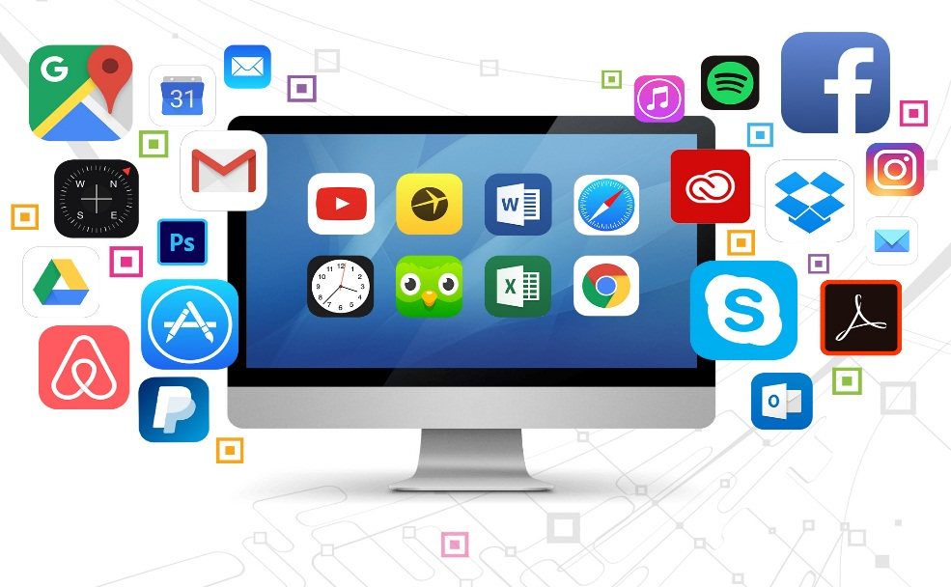
What is Software?
A set of instructions, data or programs used to operate computers and execute specific tasks
Intangible (untouchable) part of a computer system
Types of software
Application software
System software

Slide 3
Software
Application Software
System Software
Tailored Software
Packaged Software
Operating System
Language Translator
Utility Software
.
Assembler
Complier
Interpreter

Slide 4
Types of computer software
Application Software
Tailored software
Packaged software
System Software
Operating software
Language translator
Assembler
Compiler
Interpreter
Utility Software

Slide 5
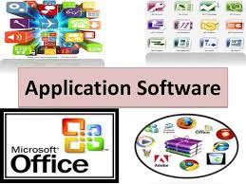

Application Software
A computer software package that performs a specific function directly for an end user or, in some cases, for another application
Types of application software:
Tailored Software / Customize Software
Packaged Software / General purpose software

Slide 6
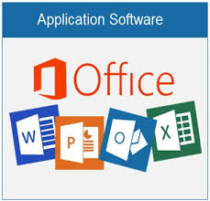

Tailored software (customized software)
Software that has been developed specifically for a single person, company, or organization
For example the software used by school\ college, banks etc
Packaged software (general purpose Software)
Collection of programs that perform similar functions or have similar features
Most famous example of this kind of software are Microsoft Office, Adobe package etc.

Slide 7
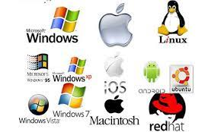
System Software
A type of computer program that is designed to run a computer's hardware and application programs
Types of system software
Operating system
Language translator
Utility software

Slide 8
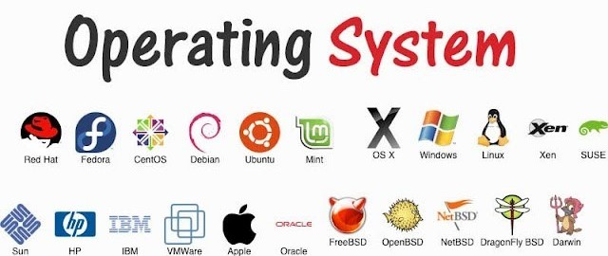
Operating system (OS)
A program that controls the execution of application
Acts as an interface between application and computer hardware
Examples : Mac OS, Windows, Linux, ubuntu, Apple iOS, etc
Types of OS:
Based on mode of user
Based on processing method
Based on user interface

Slide 9
Types of Operating Software
Based on mode of user
Single user
Multi user
Based on processing method
Batch processing
Multi tasking
Multi programming
Multi processing
Time sharing
Embedded operating system
Real time operating system
Based on user interface
GUI(Graphical User Interface)
CUI(Character User Interface)

Slide 10
Functions of OS
Input Output(I/O) Management
File Management
Memory Management
Protection and Security
Process Management
Interrupt Management
Paging
Virtual memory
Event Logging
Process Scheduling
User Interface
Command Interface
Deadlock Preventions

Slide 11
Input/Output Management
It handles different input and output devices connected to the computer
It is responsible to run driver software for specific hardware when required
It allows the flow of data through different terminals and other input/output devices
File Management
A file system is organized into directories for easy navigation and usage
It creates or delete files or directories
It organise, store, retrieve, name and protect the files

Slide 12
Memory Management
The operating system manages the Primary Memory or Main Memory.
Main memory is made up of a large array of bytes or words
Main memory is fast storage and it can be accessed directly by the CPU
It manage primary memory
Protection and Security
It secure data from unauthorized access
It encrypt user data with username and password
It allows or disallows the access from other system

Slide 13
Process Management
Decides the order in which processes have access to the processor
Is also called process scheduling
Allocates the CPU that is a processor to a process
De-allocates processor when a process is no more required
User Interface
It provides the interface between user and hardware
Interface consist set of commands or menu
It is the layers that actually communicates with the user

Slide 14
Objectives of OS
The objectives of operating system are:
It makes computer system convenient to use in efficient manner
Hides details of hardware resources from users
Acts as an intermediary between hardware and its users
Manages resources of computer system
Keep track of who is using which resources from different users
Provides fair sharing of resources among users and programs

Slide 15

Language translator
Converts the human understandable language or programs into machine level language
Types :
Assembler
Compiler
Interpreter

Slide 16
Assembler
A program that takes basic computer instructions and converts them into a pattern of bits that the computer's processor can use to perform its basic operations
Compiler
A program that translates code written in a high-level language into a set of machine-language instructions that can be understood by a digital computer's
Interpreter
A computer program that is used to directly execute program instructions in high-level programming languages

Slide 17

Utility Software
System software that helps to maintain the proper and smooth functioning of a computer system
Assists the Operating System to manage, organize, maintain, and optimize the functioning of the computer system
Examples : antivirus software, File Management System, Disk Management Tools, Compression Tools, Disk Cleanup Tool etc.

Slide 18
Programming Language
A computer language that is used by programmers (developers) to communicate with computers
Types:
Low Level Language
Machine Level Language(First Generation Language)
Assembly Level Language(Second Generation Language)
High Level Language
Procedural Oriented Language(Third Generation Language)
Problem Oriented Language(Fourth Generation Language)
Natural Language(Fifth Generation Language)

Slide 19
Programming Language
Low Level Language
High Level Language
Machine language (1GL)
Assembly Language (2GL)
Procedural Oriented Language (3GL)
Problem Oriented Language (4GL)
Natural Language (5GL).

Slide 20
Low Level Language
Machine dependent language
Difficult and time consuming to develop program
Requires detailed knowledge about hardware architecture
Types :
Machine Language(First Generation Language)
Assembly Language(Second Generation Language

Slide 21
Machine Language(1st Generation Language)
Advantages of machine language:
Disadvantages of machine language:
Consists of binary strings of digits numbers(0 and 1)
One language that processor directly understands (no use of translators)
Difficult to debug
Directly understands by the computer
Language translator is not required
Faster execution speed
Efficient use of memory and processor
Difficult and time consuming
Codes have to be remembered
Programmers should know about hardware architecture

Slide 22
II. Assembly Language (2nd Generation Language Advantages of Assembly Language: Disadvantages of Assembly Language:
Some programs written in this language is readable by humans (ADD, SUM, DIV .etc)
Converts the code by assembler
Easy to debug
Easy to develop and debug program
Does not need to know exact storage location of data
Fast execution speed
Cannot be executed directly
Assembler is needed to translate the written language
Machine dependent language

Slide 23
High Level Language
Codes or programs is close to human understandable language
Less time consuming and less errors
Uses translator like compiler and interpreter to convert it into machine language
Examples: Pascal, BASIC, C, PHP, FORTAN etc.
Types :
Procedural Oriented Language (3rd Generation Language)
Problem Oriented Language (4th Generation Language)
Natural Language (5th Generation Language)

Slide 24
I. Procedural Oriented Language (3rd Generation Language) Advantages of procedural oriented language: Disadvantages of procedural oriented language:
It uses English and mathematical statements to develop program
Designed to express the logic and the procedure of a problem
Able to solve variety of problem because of flexibility
Easier to develop and debug programs
Does not need to know the hardware architecture
More advanced and user friendly software can be developed
Programs cannot be executed directly
Execution of programs is slower
Translators like compiler and interpreter is required to translate into machine language

Slide 25
II. Problem Oriented Language (4th Generation Language) Advantages of Problem Oriented Language: Disadvantages of Problem Oriented Language:
It is the non procedural or problem oriented language
It is result oriented and includes database query language
It is high level programming language
Easy to understand and learn
Increase speed for developing programs
Less chance of errors
Translator should be used to translate codes into machine level language
Execution will be slow

Slide 26
III. Natural Language (5th Generation Language) Advantages of Natural Language: Disadvantage of Natural Language:
It uses normal English language for programming
It is based on the concept artificial intelligence
This language is still in developing stage
Easier to develop and debug programs
More advanced and user friendly software can be developed
Machine independent language
It uses translator to translate program into object code
Execution of program will be slow

